Slide 1
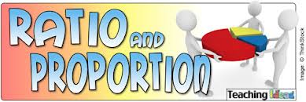
APPLICATIONS

Slide 2
7.RP.3
Use proportional relationships to solve multistep ratio and percent problems.
Examples: simple interest, tax, markups and markdowns, gratuities and commissions, fees, percent increase and decrease, percent error.

Slide 3
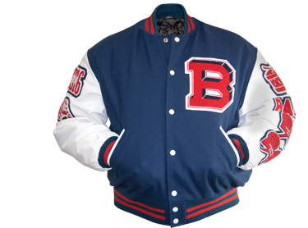
A jacket is marked down 25%. Its original price was $59.99.
Use mental strategies to determine the price of the discounted jacket (before sales tax).
If sales tax is 7.5% what is the total cost of the jacket?
Ethan said that 25 -7.5 is 17.5 so he can just take 17.5% of 59.99 to get the discount of the original price. Do you agree with Ethan’s thinking?
Notes:
About $45

Slide 4
A shirt is on sale for 30% off the original price. The sale price is $15. What was the original price and what was the markdown?
Notes:
Original: $21.04
Markdown: $6.04

Slide 5
A business owner spent $15 on a t-shirt for his company. He marked up the price of the shirt by 30%. What is the selling price of the shirt?
How did you determine the selling price?
Notes:
$19.5

Slide 6
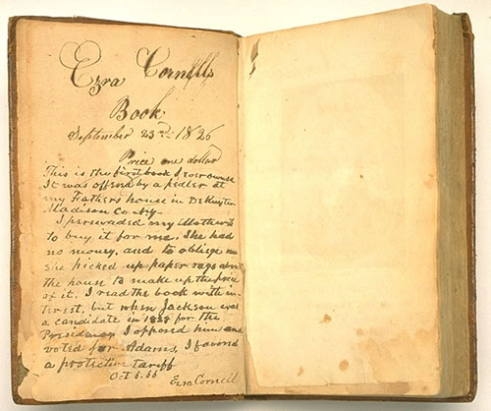
A customer buys a book that has an original price of $32. The book is discounted by 25%. Local sales tax is 6%.
What is the total amount (including tax) that the customer pays for the discounted book?
Notes:
$25.44

Slide 7
Sara saved her money to buy a computer that cost $1,000.
When she went to buy the computer, the price had been increased by 30%.
How much more money did she need to buy the computer (assuming she had the $1,000)?
Notes:
$300

Slide 8
The next week the computer shop had a sale and reduced all prices by 25%.
Did Sara have enough money to pay for the computer in the sale?
Notes:
1,300 x .25 = $325 reduction
New price $975

Slide 9
The directions on a bottle of bleach say “Mix ½ cup of bleach with a gallon of water.” The ratio of bleach to water is 1 to 32. A student made the following double number line to determine the amount of water needed to mix with 3/4 cup of bleach to make the cleaning solution. Use another strategy to determine if the student is correct.
$$\frac{1}{8}$$
$$\frac{1}{2}$$
$$\frac{3}{4}$$
32
128
192
256

Slide 10
The directions on a bottle of bleach say “Mix ½ cup of bleach with a gallon of water.” The ratio of bleach to water is 1 to 32.
How many fluid ounces of bleach should be mixed with 160 fluid ounces of water to make the cleaning solution?
Notes:
.625

Slide 11
The directions on a bottle of bleach say “Mix ½ cup of bleach with a gallon of water.” The ratio of bleach to water is 1 to 32. A bottle contains 1 quart of bleach.
What is the total number of quarts of cleaning solution that can be made using the entire bottle of bleach?
Notes:
4 quarts

Slide 12
You are expecting 100 people at your party. Only 75 people come.
Use mental strategies to determine the percent error.
Notes:
25%

Slide 13
The directions on a bottle of bleach say “Mix ½ cup of bleach with a gallon of water.” The ratio of bleach to water is 1 to 32. A spray bottle holds up to 1 cup of the cleaning solution. When the spray bottle is full, what fraction of the cleaning solution is bleach?
Explain your strategy.
Notes:
1/32 or one thirty secondths

Slide 14
At a certain store, 24 couches were sold in January. The manager at the store wants to encourage the sales team to sell more couches and is going to give all the sales team members a bonus if the number of couches sold increases by 30% in February. How many couches must the sales team sell in February to receive the bonus?
Justify your solution.
Notes:
31.2 which means they actually need to sell 32 couches.

Slide 15
An employee at a camera store set a goal to earn $4,000 in May. She receives a base salary of $1,500 as well as a 12% commission for all sales. Determine if she would reach her goal if she sold $25,000 in merchandise in May.
Discuss how you know.
Notes:
Yes she would make $4,500

Slide 16
After eating at a restaurant, your bill before tax is $48.60. The sales tax rate is 6%. You decide to leave a 20% tip for the waitress, based on the pre-tax amount. How much will you leave for tip?
How much will you spend in total, including tax and tip?
Notes:
Tip: $9.72
Total: $61.24

Slide 17
A 7th grade student wants to buy some snacks and books for vacation. He has decided that he will buy three times as many snacks as books. Each of his favorite snacks costs 60¢. Each magazine costs $4.50. The sales tax rate on both types of items is 6 ½ %. How many of each item can he buy if he has $20 to spend?
Notes:
Snacks: 20
Magazine: 14.85

Slide 18
There were 32 boys and 28 girls in a karate class last year. This year the number of boys increased by 25% but the number of girls decreased by 10%. Was there an increase or decrease in overall membership?
Find the overall percent change in membership
of the club.
Notes:
Increase by 15%

